Slide 1
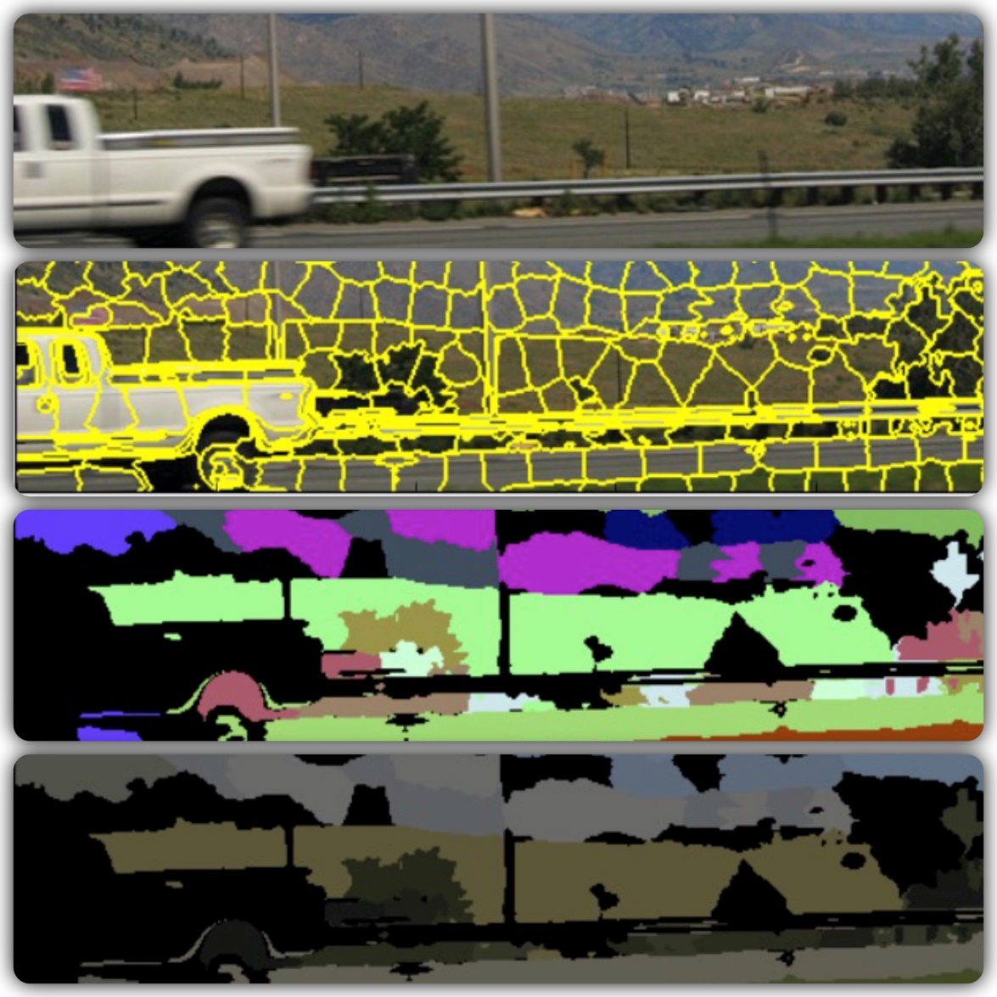

Image Classifier
Pixel Dawgs
NICK ROSETTI
VEERA KARRI
MANISH BORSE
SHREYA GUPTA

Slide 2
Overview
Introduction
Data Acquisition and Data Engineering
Image Processing
SLIC
DBSCAN
Sobel filtering
Machine Learning
GUI
Supervised learning using SVM
Results
Conclusion and Future work
Poster

Slide 3
Introduction
What is an Image Classifier?
A tool that will show what an image has based on the visual content
What can we achieve from that?
Simplification in categorizing the images
Fast searching through images
It’s really cool!!!

Slide 4
Data Acquisition and Data Engineering
Open source raw data is provided by Yahoo-Flickr
Image URL (10 files, 5GB each)
File contains image ID and the associated url to download the file
~300,000 images were downloaded
Small subset was used due to computational limitation
Auto-tags (14GB)
File contains image ID and associated auto-tags
File was divided in two different files, because traditional processing was hard on such a large file
Index column was changed to auto-tags, now all the auto-tags are associated with the image ID

Slide 5
Machine Learning – Supervised Learning Using SVM
SVM stands for Support Vector Machine
Used SVM classification library from scikit-learn
This type of classification is based on feature vectors generated by processing the segments in each image
The feature vector we used is a 1-D vector of numerical values representing a segment of an image
Each vector is associated with an image tag, e.g. “sky”
Using the feature vectors along with the labels for each tag, a machine learning model was created
This model was then used to predict what tags the new image could have
The SVM provided tags and probabilities associated with each tag

